Slide 1
Census 2021: finding the data you need

Slide 2
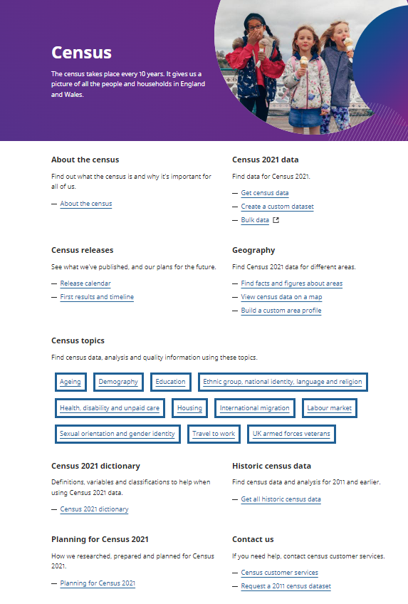
Home page for census 2021: https://www.ons.gov.uk/census
Census 2021 took place in England and Wales around Census Day on 21 March 2021
It achieved a 97% response rate overall

Slide 3
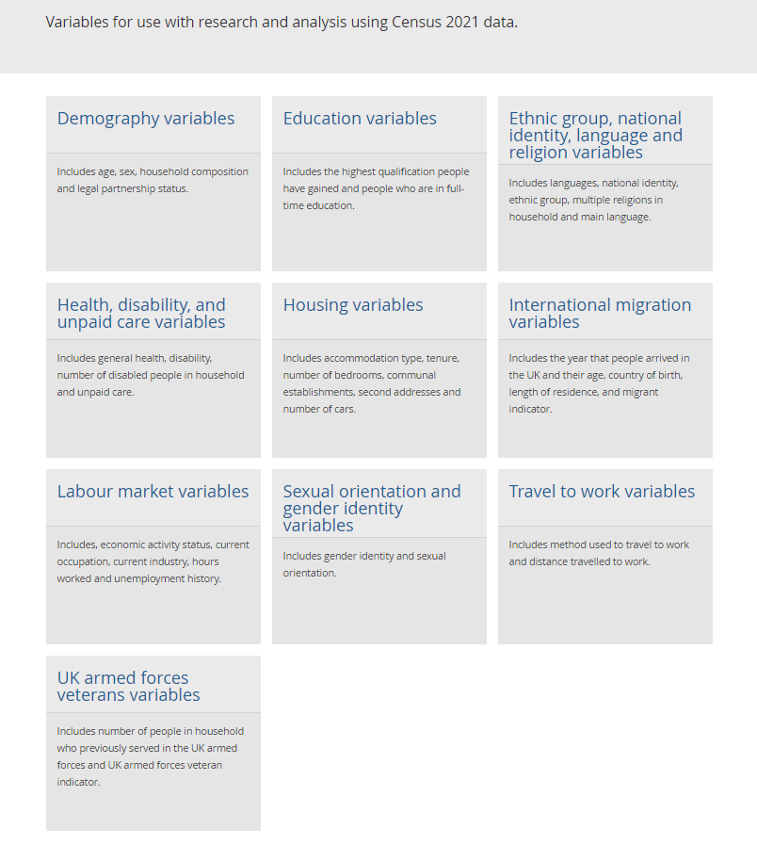
Variables in Census 2021 by topic
https://www.ons.gov.uk/census/census2021dictionary/variablesbytopic
Shows you everything that has been measured and provides definitions as well as whether it is comparable with 2011 census data

Slide 4
A range of Census 2021 outputs from off-the shelf to fully tailored

Slide 5
Tables already created by the Office for National Statistics
The Office for National Statistics (ONS) has provided a range of ways of accessing, interacting with and specifying the data available from Census 2021.
These include pre-specified tables which allow some options for tailoring if desired. These tables could be:
Univariate - i.e. they contain a single variable such as religion or
Bivariate - i.e. they contain two variables, for example, gender identity and general health
Multivariate, i.e. they contain more than 2 variables, such as Provision of unpaid care by general health by households with people who have a disability
All these outputs already created by the ONS (and reports where they exist) can be found here:
https://www.ons.gov.uk/search?topics=9731,6646,3845,9497,4262,4128,7755,4994,6885,9724,7367&filter=datasets&page=1&filter=bulletin&filter=article&filter=compendia

Slide 6
Custom datasets
But what if you want to combine an entirely different set of variables than those the ONS have already provided?
For example, perhaps you want to compare the proportion of people from different ethnic groups who are aged 50 to 64; live in privately rented homes and who are in poor health. That’s 4 different variables:
Age
Ethnicity
Tenure type and
General health
You can bring together whatever variables you want (with limits discussed below).
To create your own custom data set go to: https://www.ons.gov.uk/datasets/create

Slide 7
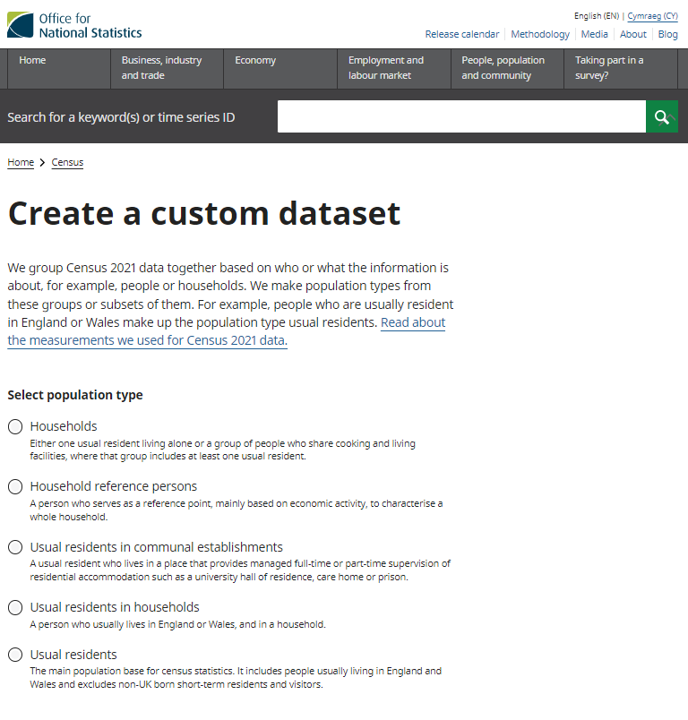
Creating a custom dataset
Select:
Population type: possible choices here
Area type
Coverage
Browse available variables

Slide 8
Selecting the population type for custom tables
If you’re interested in all the individuals who live in the population, then select Usual residents (= Usual residents in communal establishments + Usual residents in households). This is the main population base for census statistics. For example, you should select this if you want to look at characteristics specific to an individual such as health, age or ethnic group.
If you interested in things that are associated with a household, such as type of tenure or number of cars or number of bedrooms, then you should select either Households or Household reference persons.
A "household" is one person living alone, or a group of people living at the same address.
A "household reference person" (HRP) is the household member who owns the accommodation or is legally responsible for the rent. If there are joint householders, the one with the highest income is the HRP. If their income is the same, then the eldest one is the HRP.
Select household reference persons rather than households if you want to include characteristics of an individual associated with the home (say age or ethnicity) along with characteristics of the home (say tenure or overcrowding). For example, select household reference persons if you’re interested in the prevalence of overcrowding in homes headed by someone aged 60 or older.

Slide 9
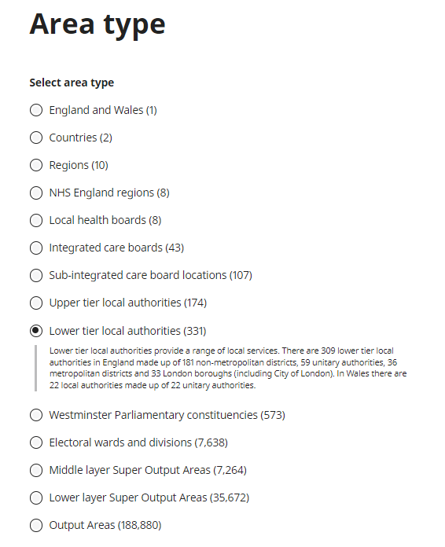
Selecting area type and coverage for custom tables
Select the area type you’re interested in, for example lower tier local authorities (LTLAs)
Coverage is the geography across which you want to compare your area type. For example, do you want data for the LTLAs in all of England (309 of them), or in one region of England, or in an upper tier local authority?
To obtain England-level national data, select countries for area type and England and Wales for coverage – you will generate data for England and for Wales and you can then select out the data for England.

Slide 10
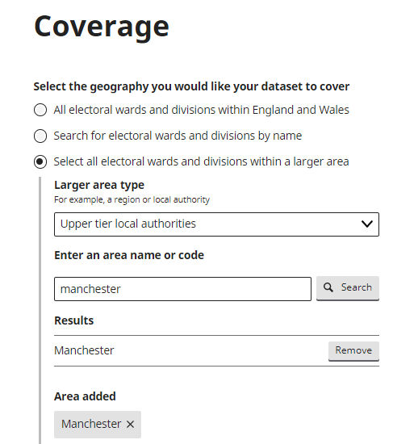
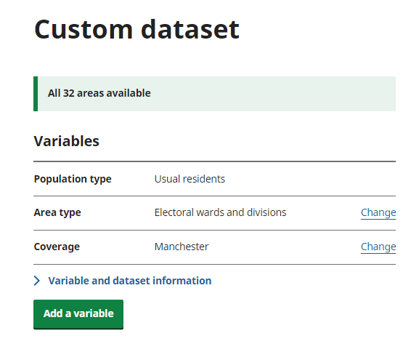
More on coverage for custom tables
Say you’re interested in data for certain electoral wards and divisions, then select electoral wards and divisions for area type. Across how wide a geography do you want to compare these (note that there are 7,639 for all of England and Wales)? If you want to compare them across a single upper tier local authority, then enter its name for coverage as shown below. In this example, I have asked that data be produced for all 32 electoral wards and divisions across the upper tier local authority of Manchester.

Slide 11
Selecting variables for custom tables
Add variables from list available – note there are different variables available depending on whether you’re looking at households, household references persons or residents
You can add several variables, but note!
if you have too many variables, too many categories specified for those variables and/or a geographical area that is too small, you could get a message like this:
This happens if there is a risk of identifying individuals
What to do?
You could specify a larger geographic area, reduce the number of variables or the number of categories stipulated for a given variable, for example, use 8 ethnic groups instead of 20.

Slide 12
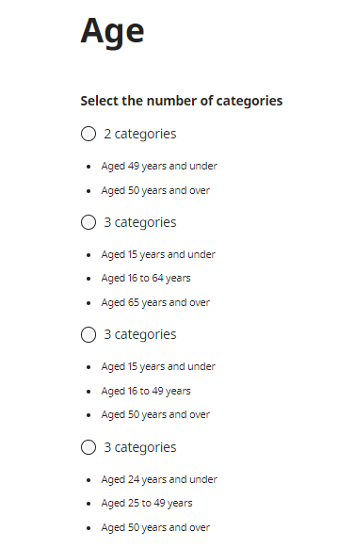
Last steps to create your custom table
Adjust the categories for your variables (there are many options, for example, you can select from 2 to 101 categories for age) or for issues of disclosure
Get the data (select format) and download
Create pivot tables in excel to get data in format desired

Slide 13
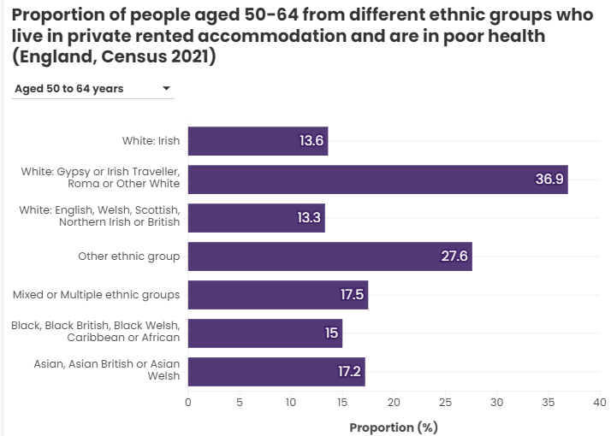
An example: combining age, ethnicity, tenure and health
The ethnic group with the highest proportion of private renters aged 50-64 in poor health is White: Gypsy or Irish traveller (36.9%) and the lowest is White British (13%).

Slide 14
Some handy “off-the shelf” Census 2021 resources

Slide 15
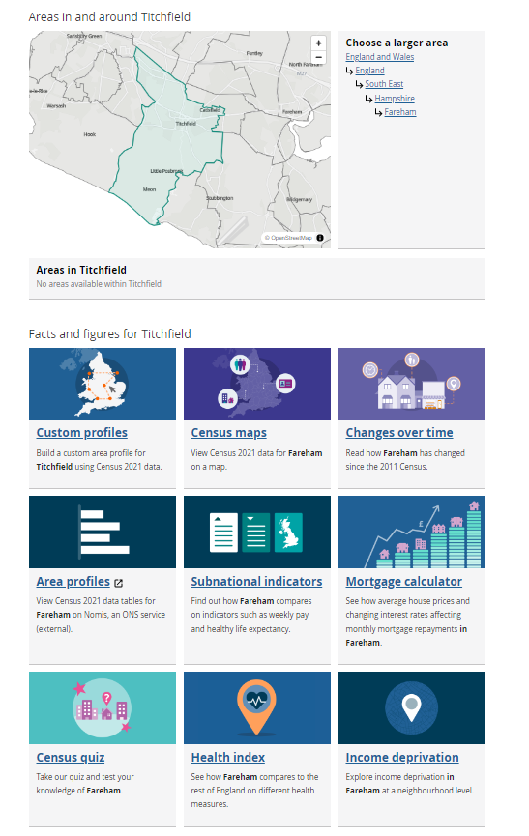
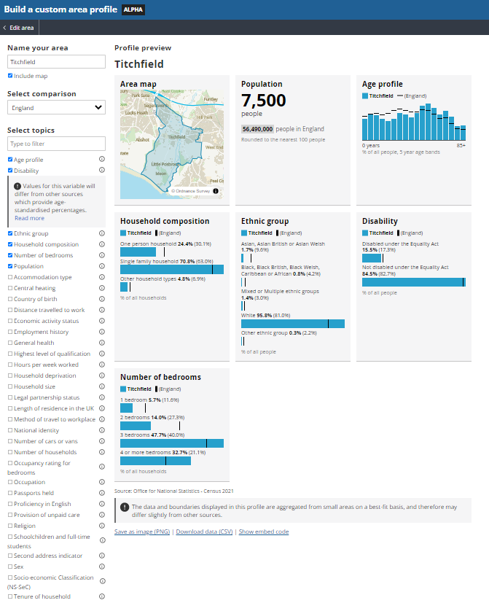
Find facts and figures about areas in England and Wales
Go to: https://www.ons.gov.uk/visualisations/areas

Slide 16
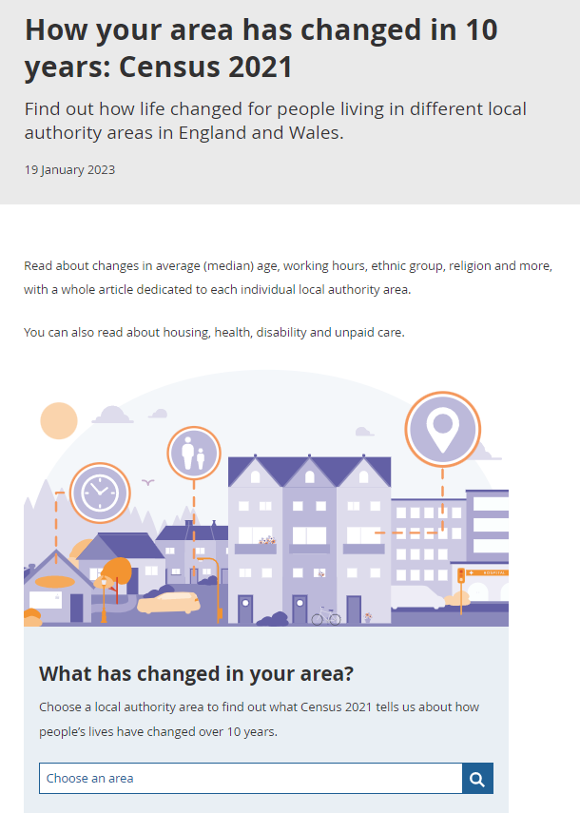
https://www.ons.gov.uk/peoplepopulationandcommunity/populationandmigration/populationestimates/articles/howyourareahaschangedin10yearscensus2021/2022-11-08
Comparing the 2021 and 2011 census

Slide 17
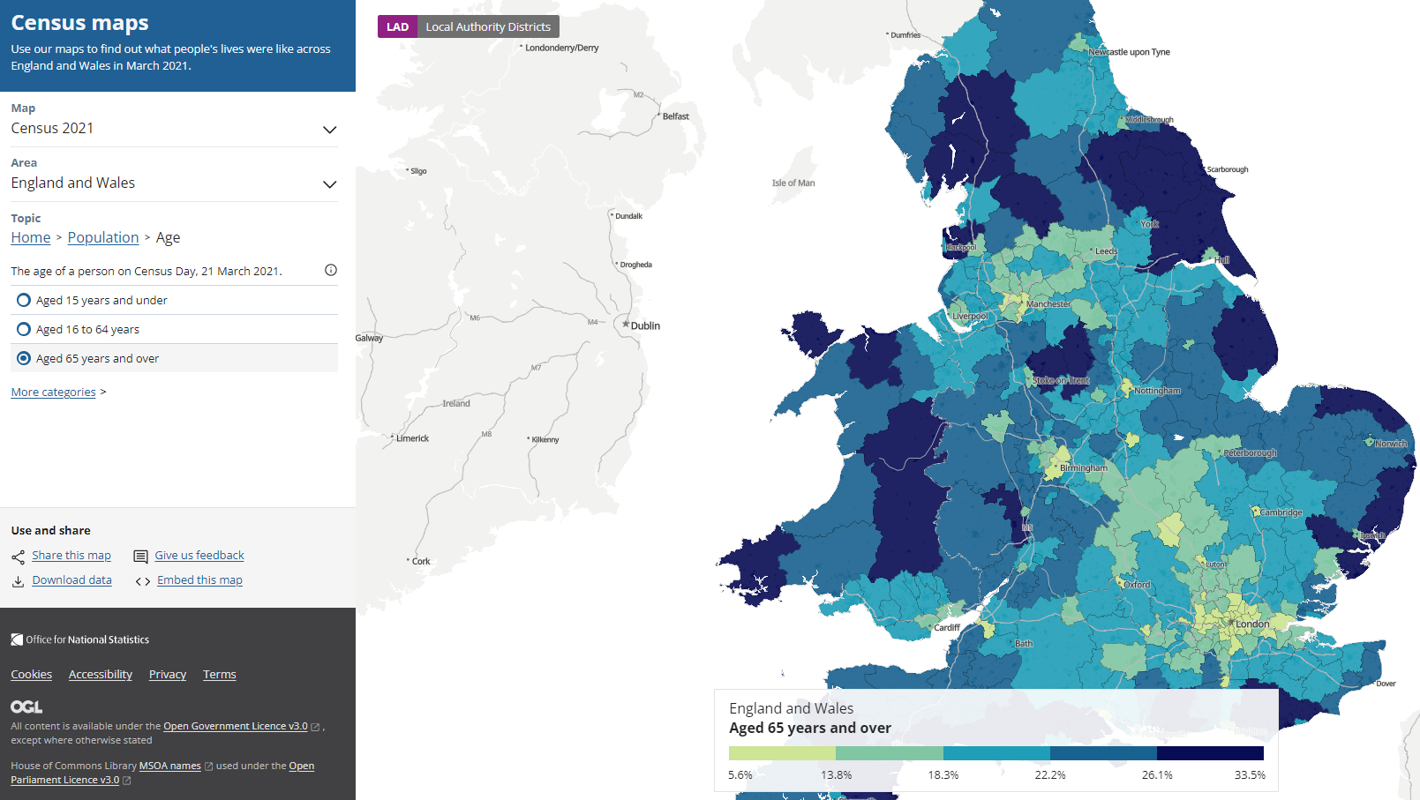
Go to: https://www.ons.gov.uk/census/maps
Note: you can explore a range of variables from the topic list but only one at a time and all expressed in percentages of the population

Slide 18
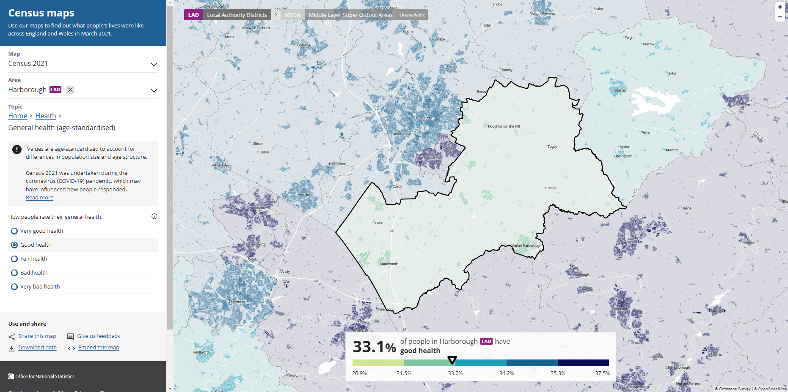
You can zoom in on the map as far as output areas

Slide 19
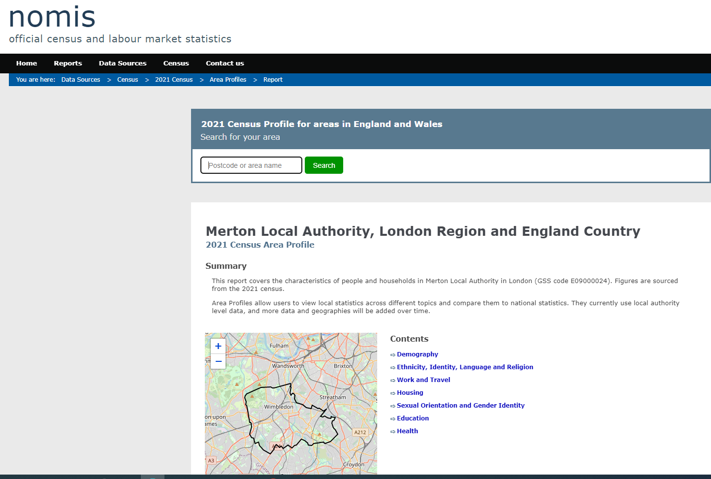
Area profiles also available on Nomis
https://www.nomisweb.co.uk/sources/census_2021/report?compare=E09000024,E12000007,E92000001
Area Profiles allow users to view local statistics across different topics and compare them to national statistics. They currently use local authority level data, and more data and geographies will be added over time.

